Slide 1



ExecutiveSummary3
View in Power BI
Last data refresh:
5/17/2021 3:25:41 AM UTC
Downloaded at:
5/17/2021 3:27:44 AM UTC

Slide 2
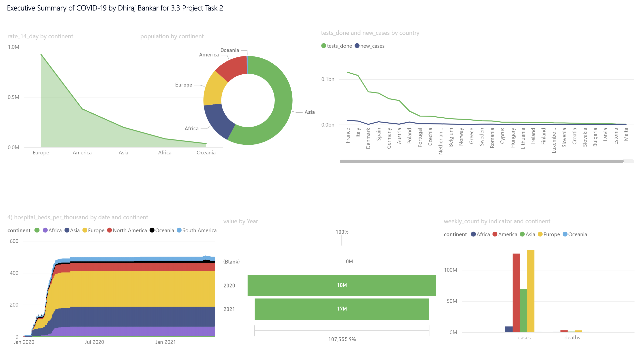
Page 1
Notes:
textbox
No alt text provided.
4) hospital_beds_per_thousand by date and continent
No alt text provided.
stackedAreaChart
No alt text provided.
donutChart
No alt text provided.
funnel
No alt text provided.
lineChart
No alt text provided.
clusteredColumnChart
No alt text provided.

